Slide 1
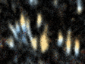
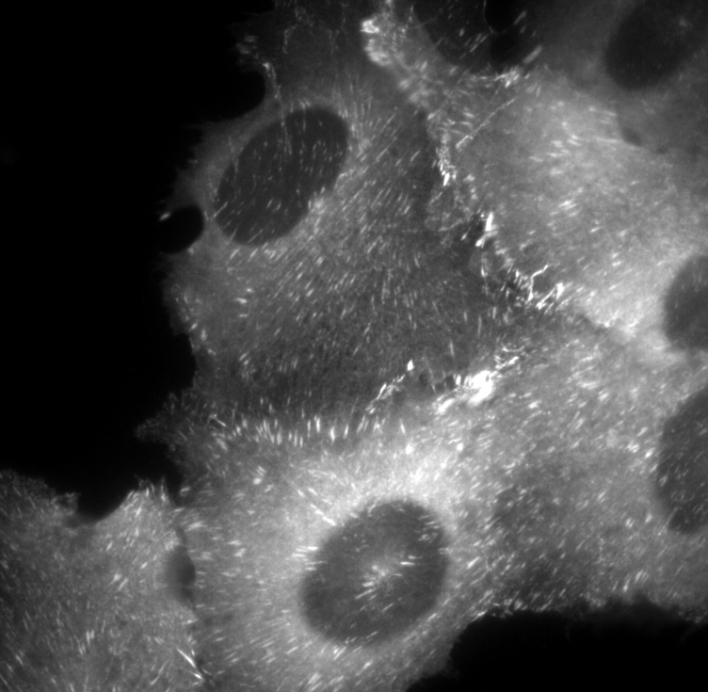
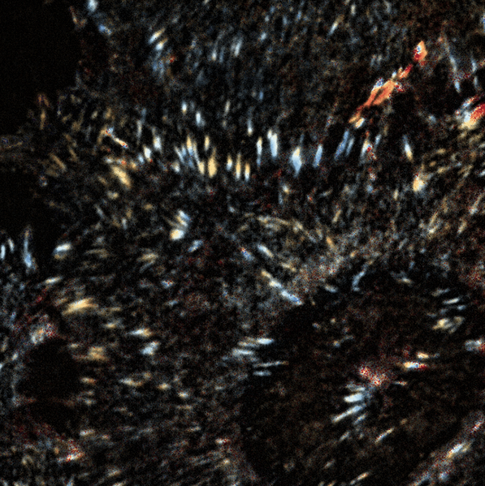
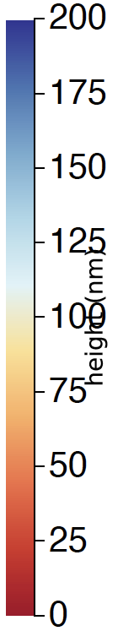
Height reconstruction of paxillin-mCherry in MCF10A
on fibronectin
(note: height of the fibronectin layer was not subtracted from the paxillin height)
Paxillin-mCherry Epi
Height reconstruction
Height (nm)

Slide 2
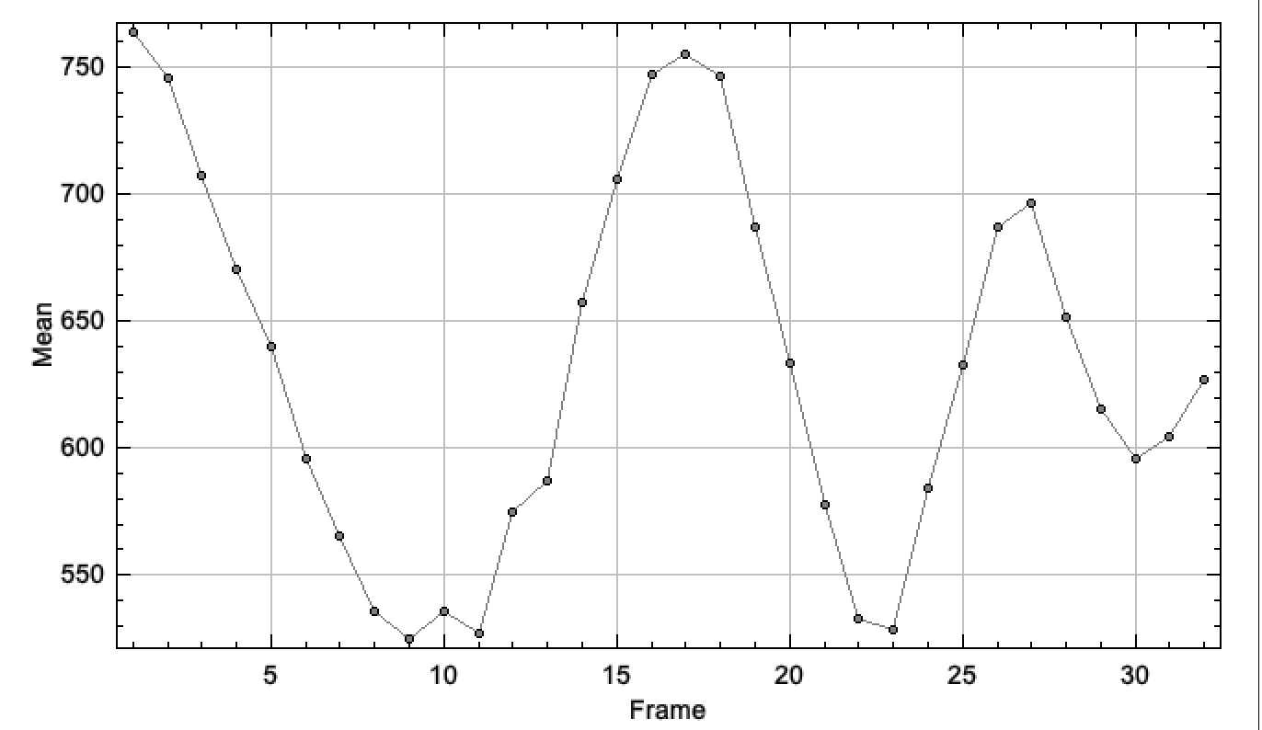
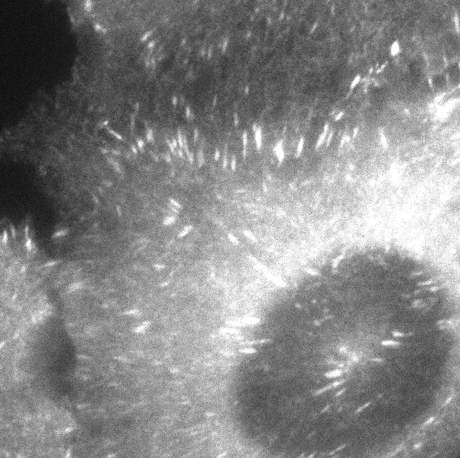
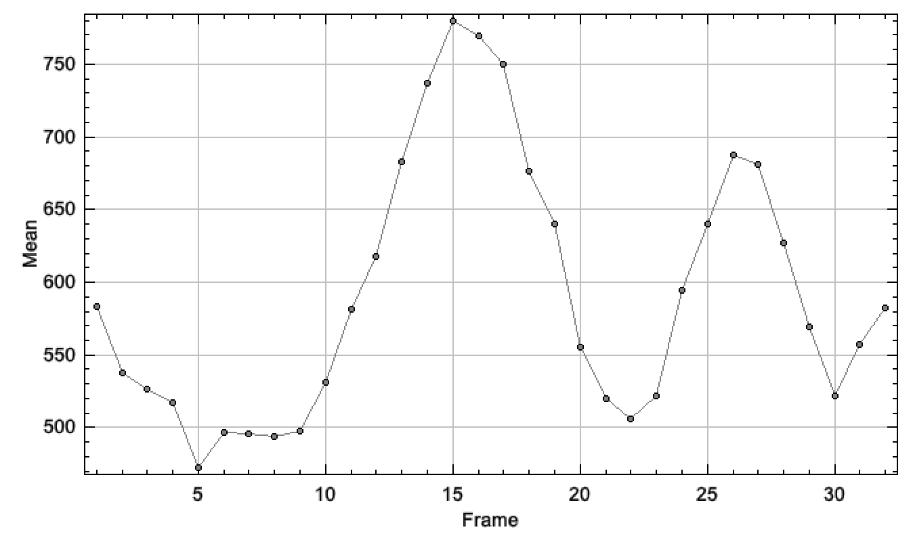
Nuclear
Peripheral

